Slide 1
Image and Video Restoration
Anisah Thomas, Naomi Logan and Chayya Datta-Bellamy

Slide 2
Goal
Colorize and upscale old videos using deep learning to restore images and videos using Generative Adversarial Networks (GAN)

Slide 3
Background

Slide 4
Background- Generative Adversarial Notebooks (GAN)
GANs are a type of artificial neural network architecture used for unsupervised machine learning.
GANs consist of two neural networks: a generator network and a discriminator network.
The generator network generates synthetic data samples that mimic the distribution of the training data.
The discriminator network tries to differentiate between the synthetic data and the real training data.
GANs have been used to generate realistic images, video, audio, and other types of data.
GANs have also been used in applications such as data augmentation, image editing, and style transfer.
Notes:
Generative Adversarial Networks (GANs) are a type of neural network architecture used in machine learning for generating new data that resembles a set of training data. GANs consist of two parts: a generator network that creates new data samples, and a discriminator network that tries to distinguish between real and generated data samples.
GAN Generative Adversarial Notebooks are notebooks that provide a way to learn and experiment with GANs. These notebooks usually include pre-built code and models for training and generating data using GANs, as well as examples and tutorials for understanding how GANs work and how to use them for specific applications such as image and text generation. In simple terms, GAN Generative Adversarial Notebooks are a tool for learning and experimenting with GANs in a user-friendly and accessible way.

Slide 5
DeOldify
DeOldify uses deep convolutional neural networks to colorize black and white images and videos.
The tool works by analyzing the grayscale values of an image or video and using a neural network to predict the corresponding color values for each pixel.
DeOldify can produce high-quality colorizations that look natural and realistic.
The tool can be customized to adjust the saturation, brightness, and other color parameters of the output.
DeOldify has been used to colorize historic photographs and videos, giving viewers a new perspective on the past.
It uses a combination of deep convolutional neural networks (CNNs) and generative adversarial networks (GANs) to colorize grayscale images and videos.
The DeOldify model is trained on a large dataset of color images to learn the mapping between grayscale and color images.
To colorize an image, the grayscale input is first passed through a CNN to generate a colorization hint map.
Notes:
DeOldify, on the other hand, is a framework for restoring and colorizing old black-and-white photos and videos using deep learning algorithms. It can be used to automatically add color to black-and-white photos and videos, as well as to restore and enhance old photos and videos by removing noise and improving contrast and brightness. In simple terms, DeOldify can be used to bring old photos and videos back to life and make them look more vibrant and realistic.

Slide 6
GFPGAN
GFPGAN is a deep learning-based project that enhances low-resolution images to higher resolution using Generative Adversarial Networks (GANs).
The model is trained on a dataset of high-resolution images and their corresponding low-resolution versions, using a combination of GANs and perceptual loss functions.
The GFPGAN model generates high-resolution images by taking a low-resolution input and upscaling it using a deep neural network.
During training, the generator network tries to produce high-resolution images that the discriminator cannot distinguish from real high-resolution images.
The discriminator network is trained to differentiate between real high-resolution images and the fake high-resolution images generated by the generator network.
GFPGAN can be used to enhance the resolution of a variety of low-resolution images, including photographs and video frames.
GFPGAN has been applied to a range of applications, such as video super-resolution, image restoration, and image enhancement.
Notes:
GFPGAN stands for "Generative Feedback Progressive GAN" and it is a framework for upscaling low-resolution images to high-resolution ones using generative adversarial networks (GANs). In simple terms, GFPGAN can be used to improve the quality of low-resolution images by generating higher-quality versions of those images.

Slide 7
Code Explanation

Slide 8
Code Explanation
Used Google Colab
Clone and build GFPGAN and DeOldify Libraries
Upscale Images
Colorize Images
Upscale with GFPGAN and colorize DeOldify
Notes:
cloning and building GFPGAN and DeOldify libraries can help you get the most out of these powerful image and video enhancement frameworks, and customize them to your specific needs. We can customize them for specific case use, make sur ewe are using the latest features, and helps us with managing dependencies. The build process typically installs all the required dependencies and ensures that they are compatible with each other. This can save you a lot of time and effort compared to manually installing and managing dependencies.

Slide 9
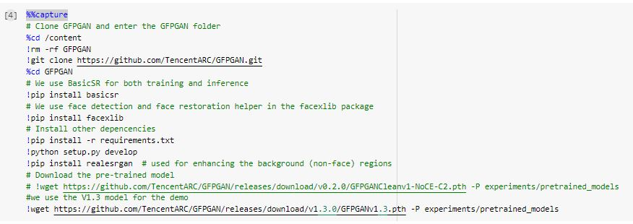
Clone and build GFPGAN

Slide 10
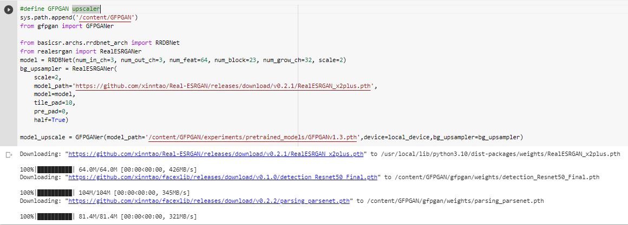

Slide 11
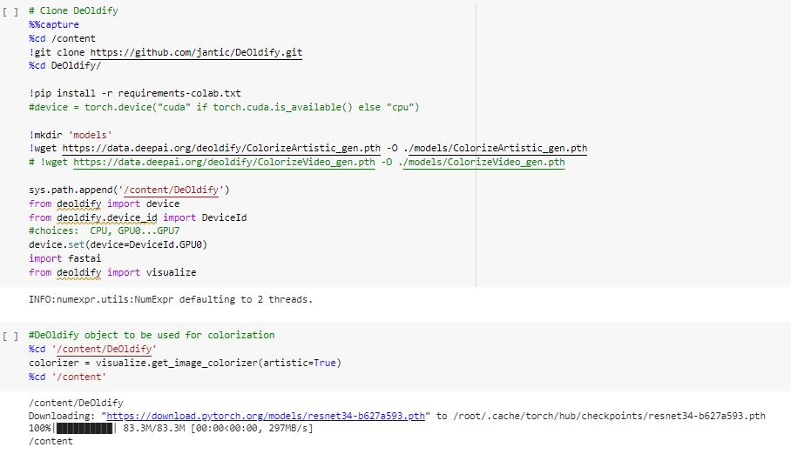
DeOldify Libraries
Notes:
Set GPU
Deoldify - visualize: get_image_colorizer()
Colorizer: DeOldify object;

Slide 12
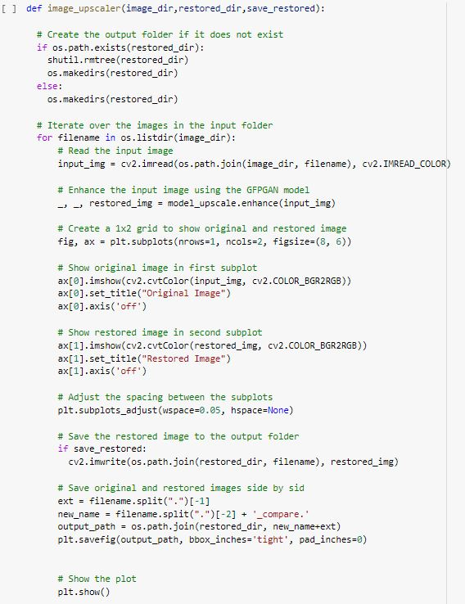
Upscale Images

Slide 13
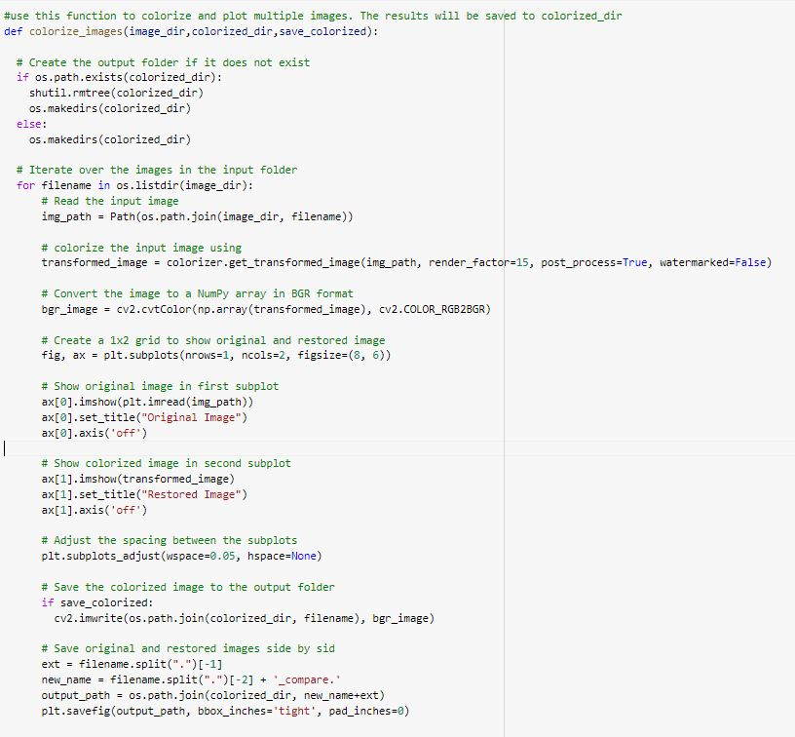
DeOldify

Slide 14
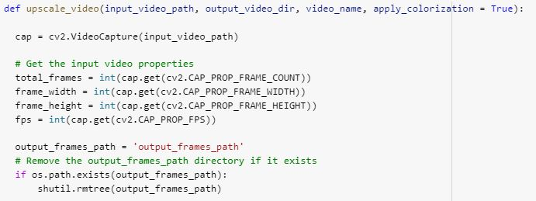
Upscaling & Colorizing Videos

Slide 15
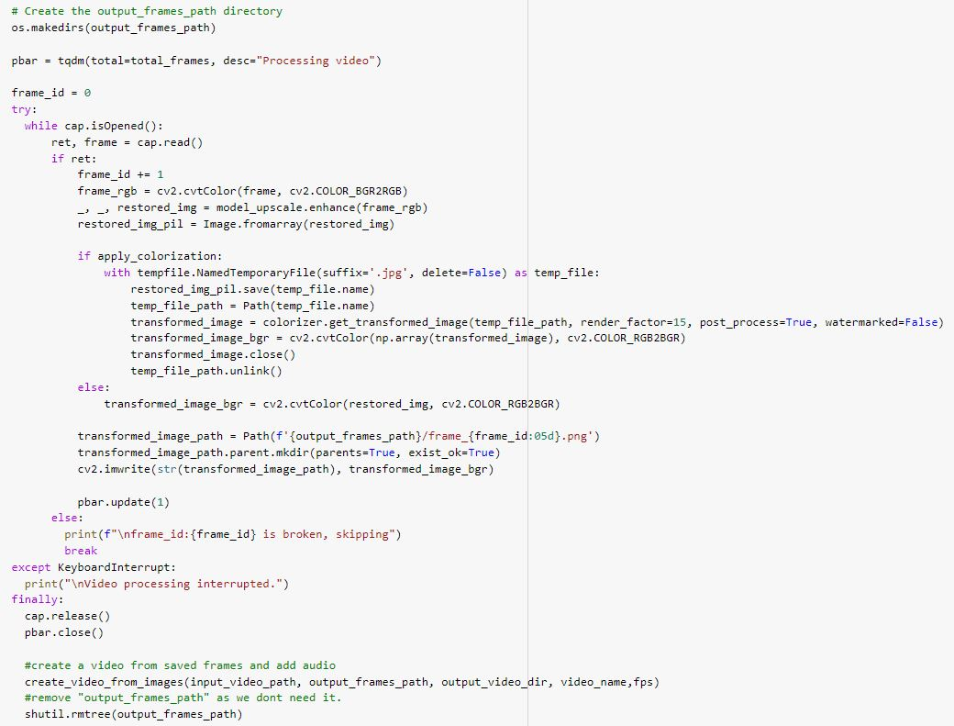

Slide 16
Results

Slide 17
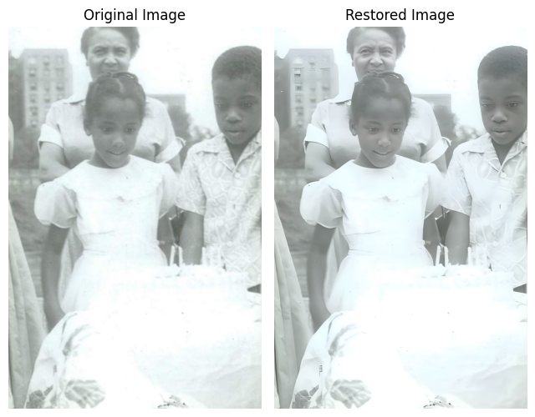
Upscale Images

Slide 18
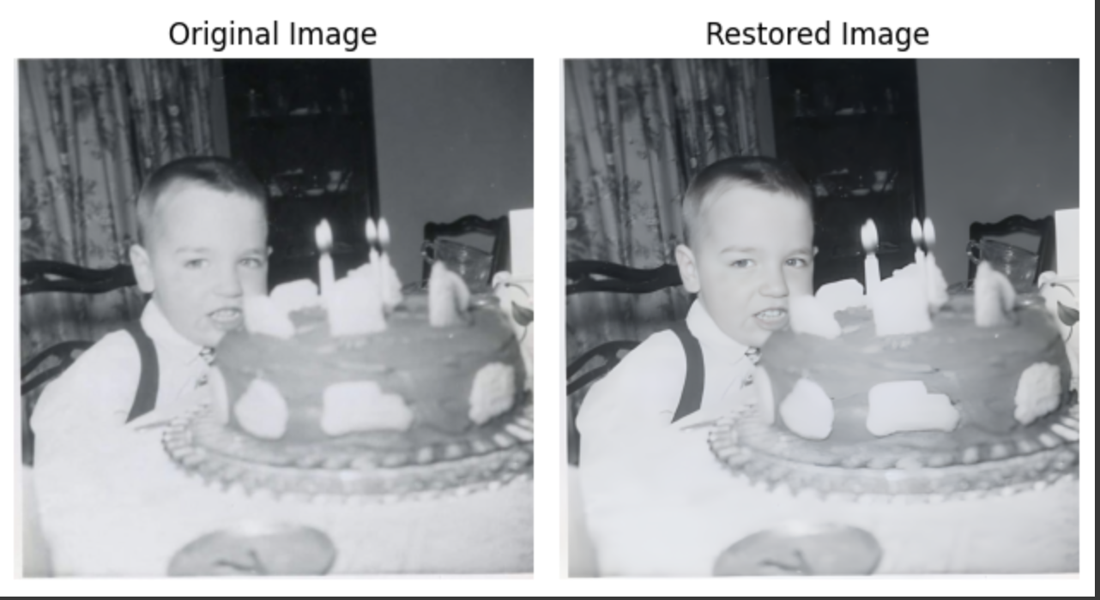
Upscale Images

Slide 19
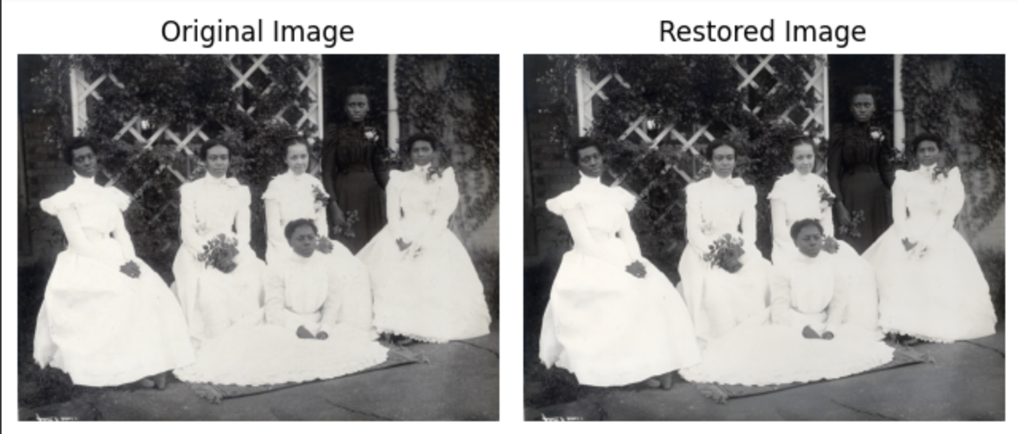
Upscale Images

Slide 20
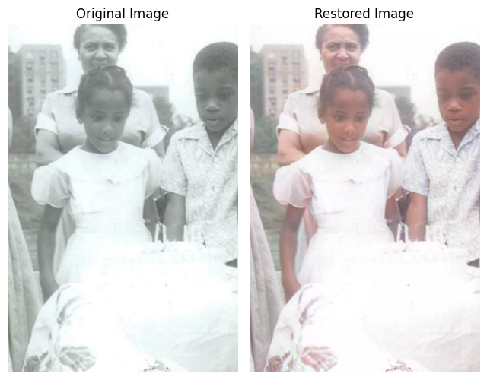
Colorize Images

Slide 21
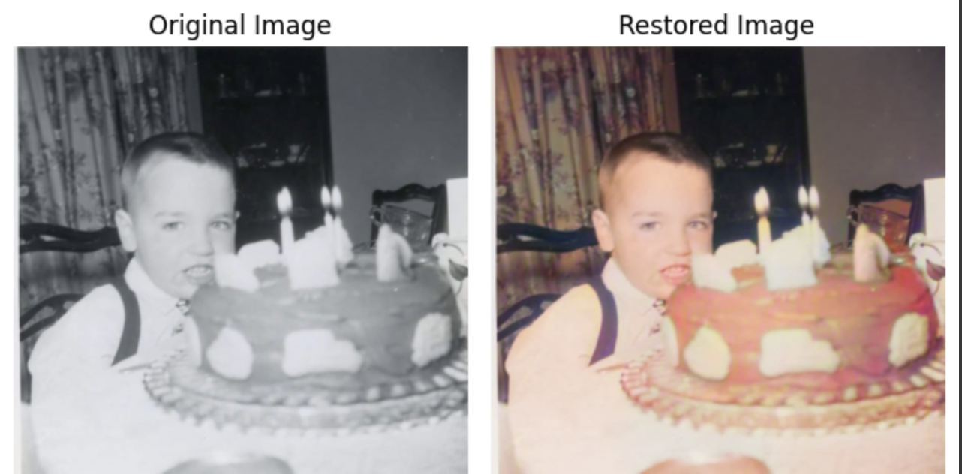
Colorize Images

Slide 22
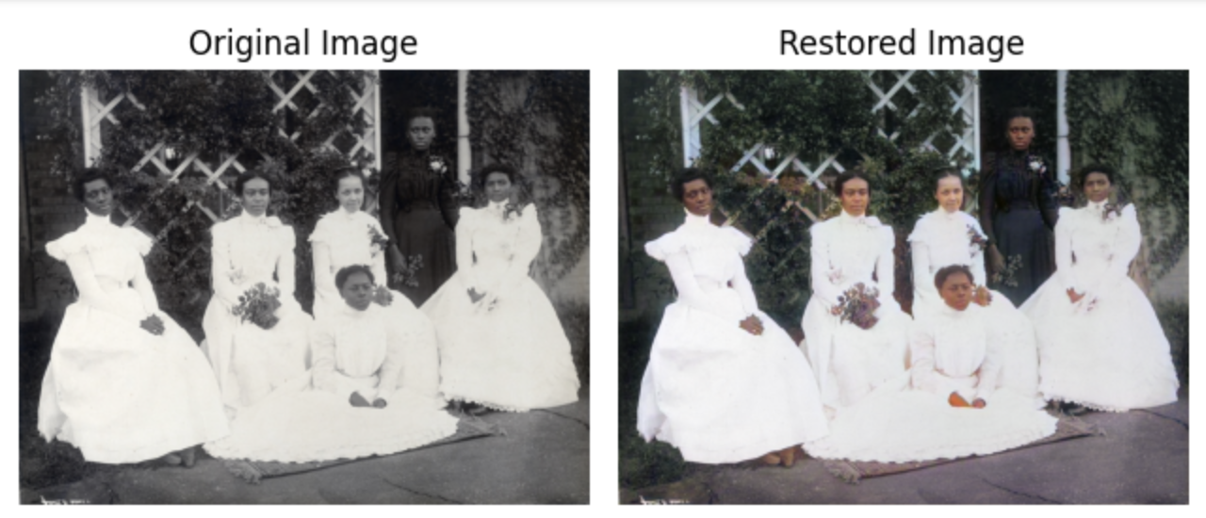
Colorize Images

Slide 23
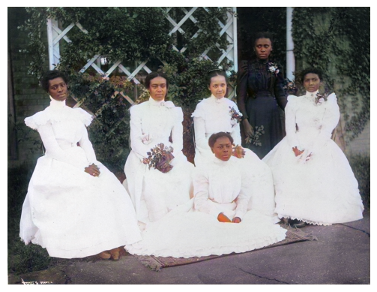
Upscale & Colorized Image

Slide 24
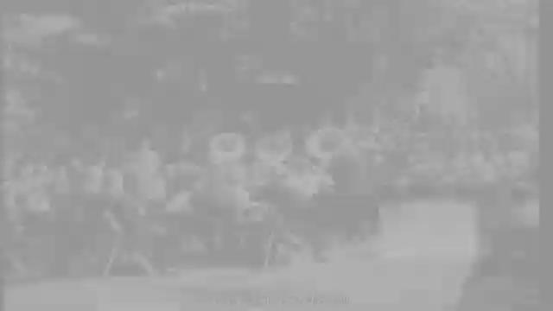
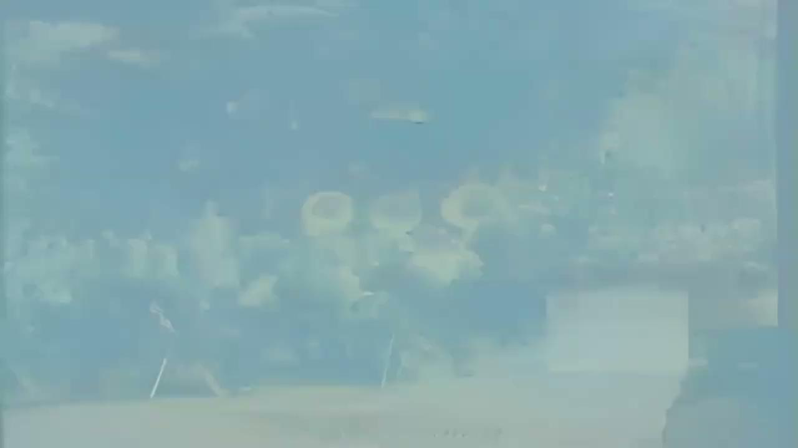
Upscaled & Colorized Video

Slide 25
Results
We were able to successfully upscale and colorize images
We also were able to successfully upscale and colorize a video
We used GAN, DeOldify, and CFPGAN
This code can be applied to helping to improve old images and let us see them in color and better resolution
This code can also be used to improve old videos

Slide 26
Thank you
Dr. Erdi Kara

